Slide 1
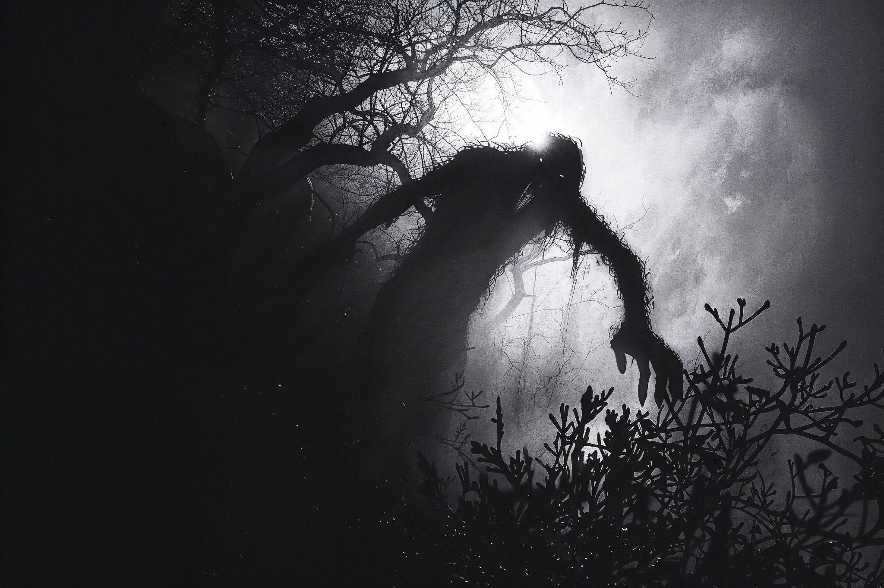
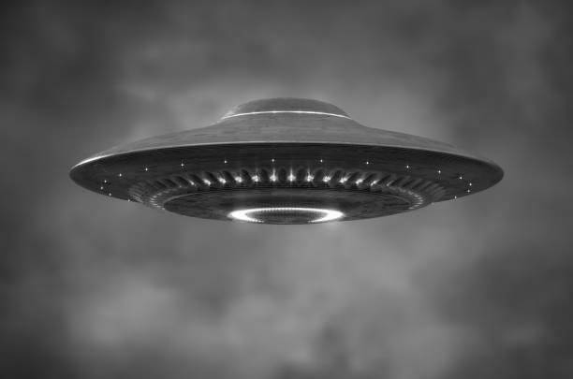
The UK’s UFO History
Reported by Chief Investigator Saad

Slide 2
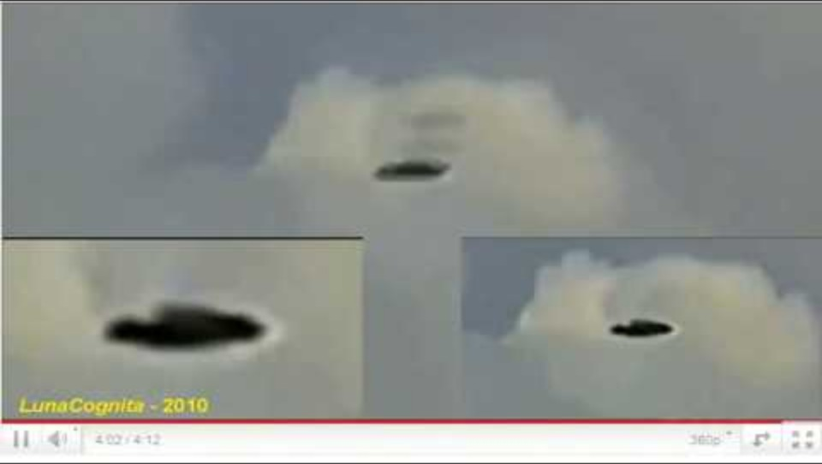
What Do You Think?

Slide 3
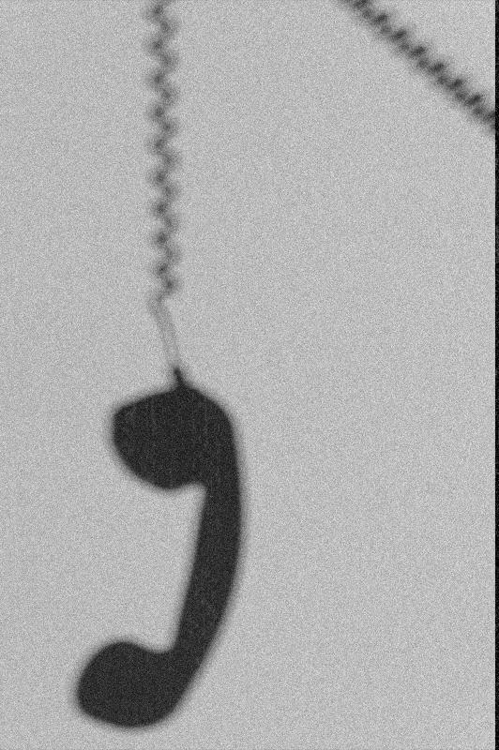
Agenda:
01
Explore why I chose this project
02
Look at 3 of the UK’s major UFO events and observe the data trends from the 1980s to today!
03
Take you on a journey to see some real reports and potentially, your first real ufo sightings!
04
Reflect on the Journey to get here

Slide 4
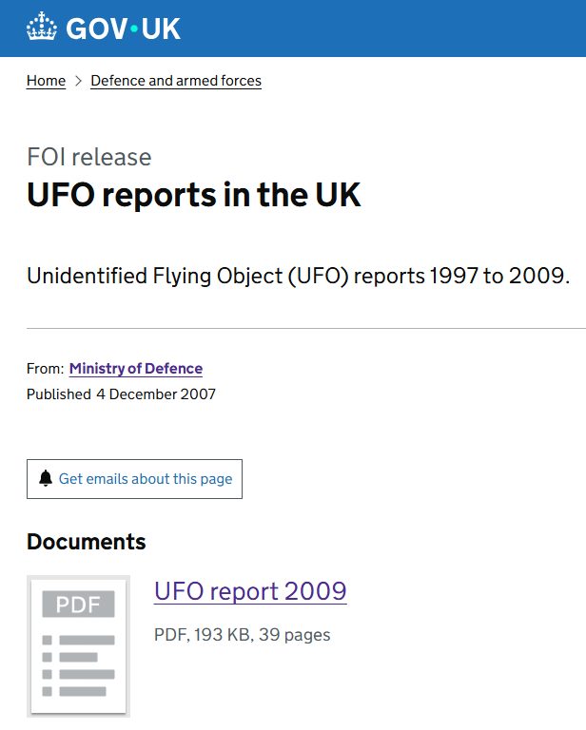
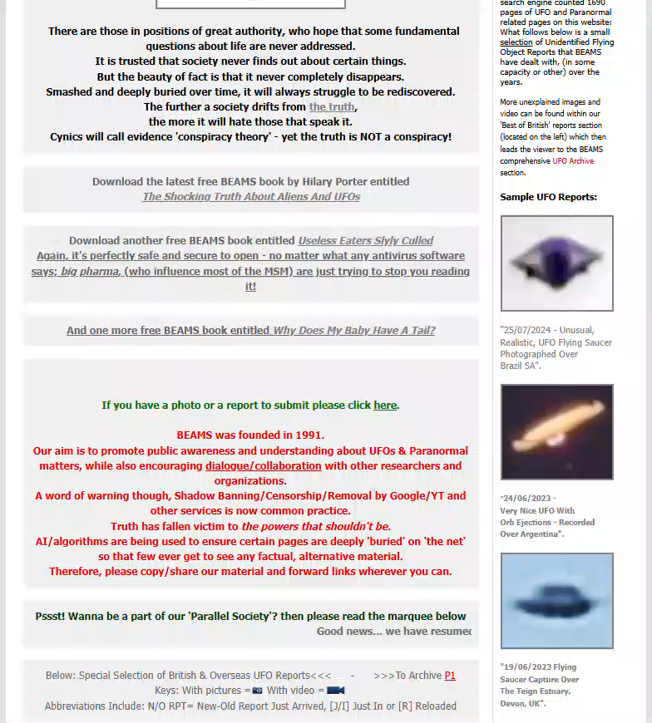

Situation and Task – Why Did I Chose This Project?

Slide 5
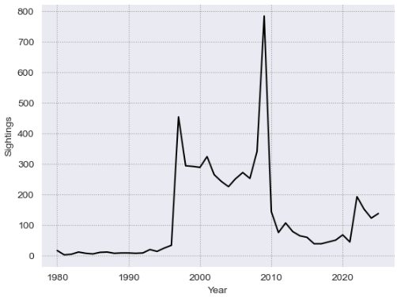
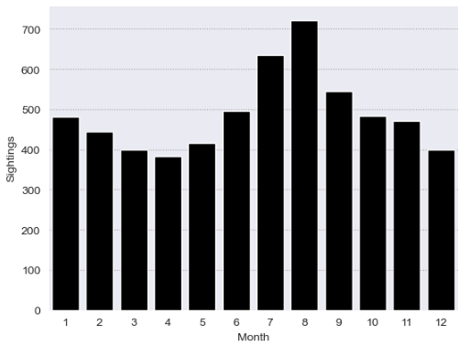
UK UFO History – What’s Been Going On?
UK UFO Sightings from 1980 - 2025
UK UFO Sightings By Month

Slide 6
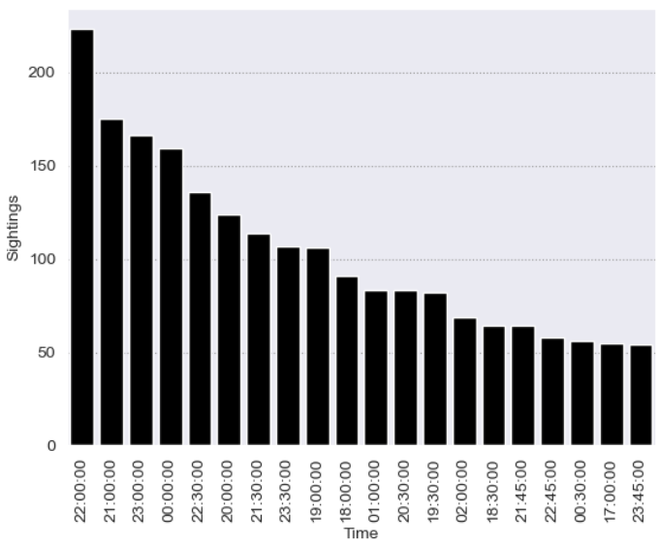
UK UFO History – What’s Been Going On?
Top 20 Most Common Times for UFO Sightings

Slide 7
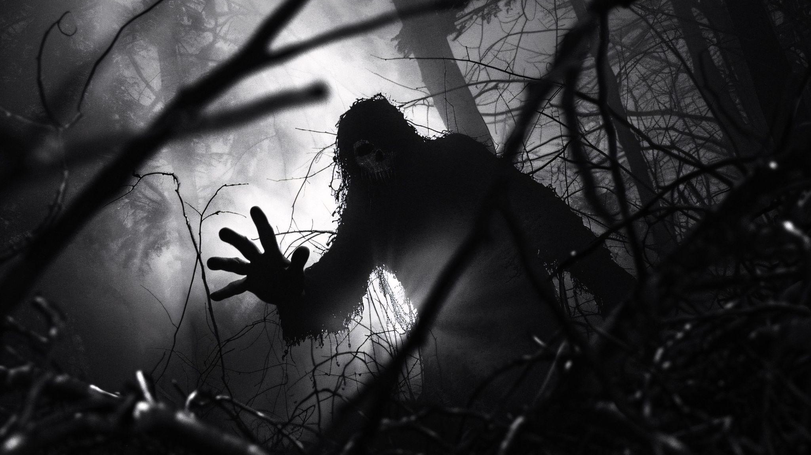


Chapter 1: 1980s to 1990s The Rendlesham Forest Incident

Slide 8
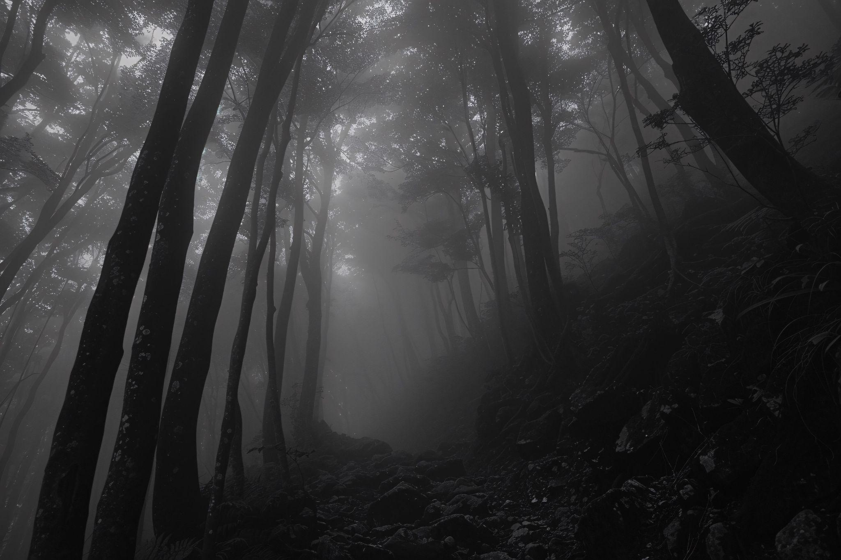
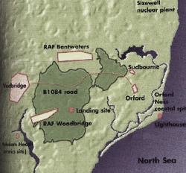
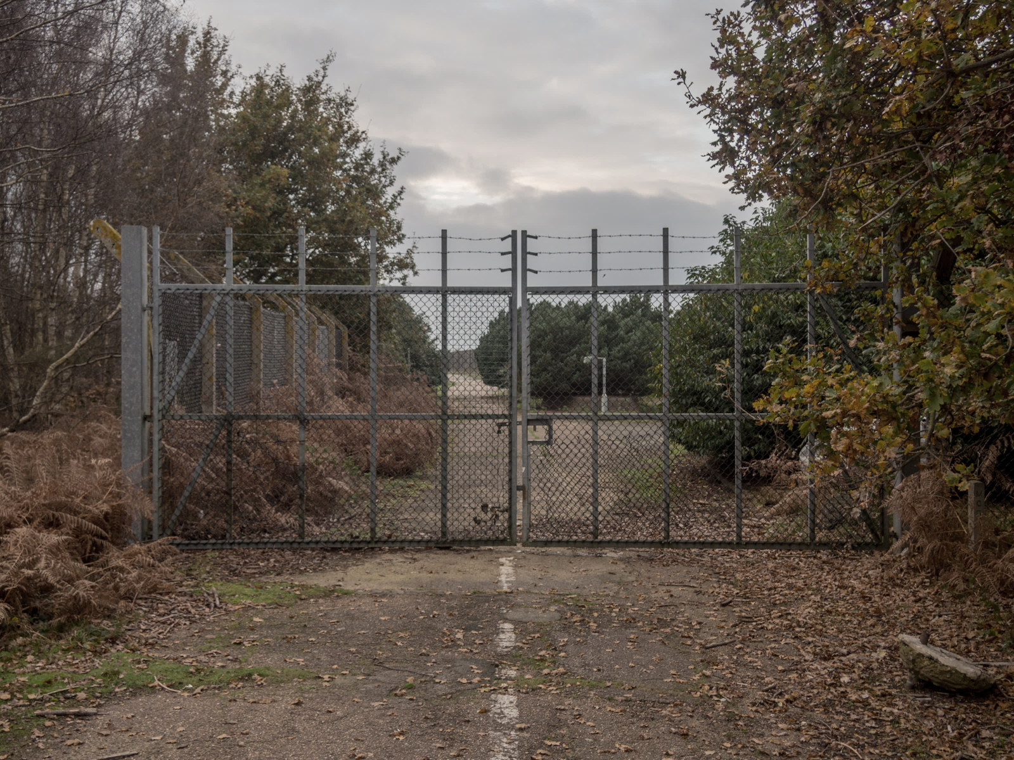
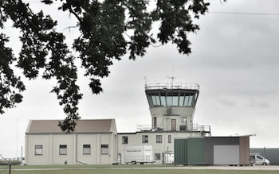
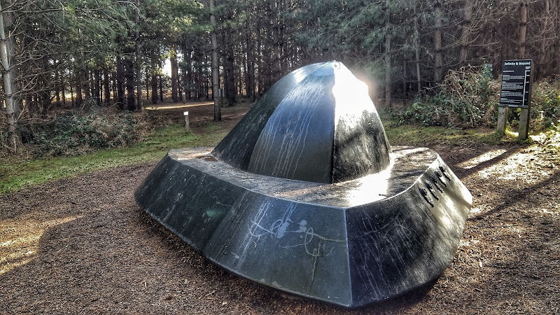
01
02
03
04
The Rendlesham Forest Incident

Slide 9
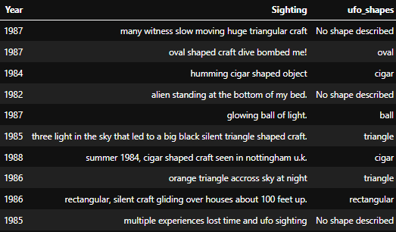
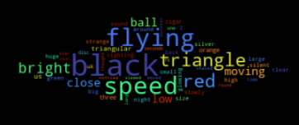
1980s to 1990s – What Are People Seeing?
What Did People See?
What Did People Report?
Triangle

Slide 10
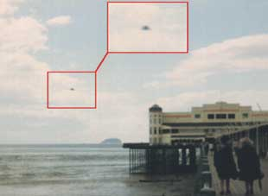
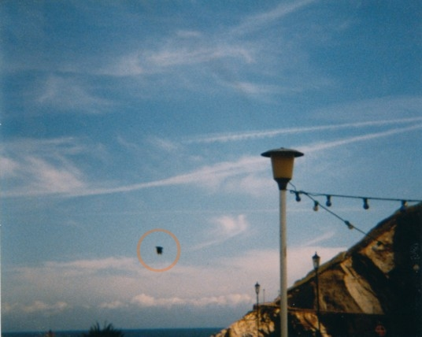
1980s to 1990s – Real Pictures of UFOs?
Picture taken: 1984, Weston, Somerset, UK
Picture taken: 1987, Ilfracombe, Devon, UK

Slide 11


Chapter 2: 1990 to 2000
The A70 UFO Abduction Case

Slide 12
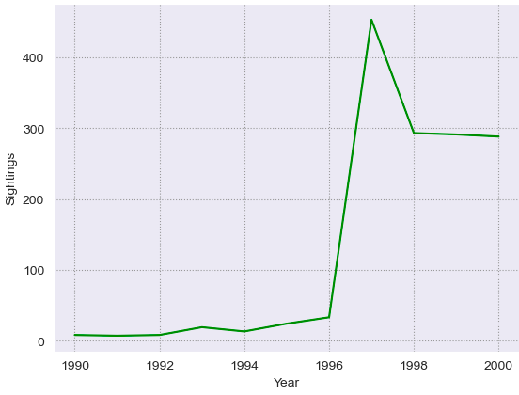
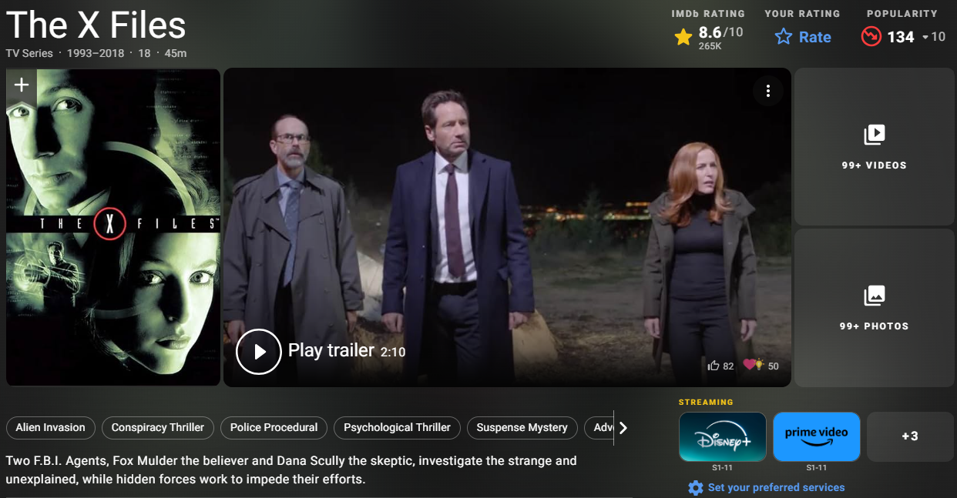
1990 to 2000 – What Happened?
UK UFO Sightings from 1990 - 2000
Was it because of the release of the X Files show?

Slide 13
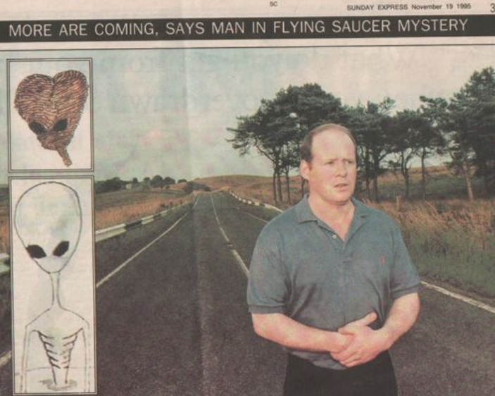
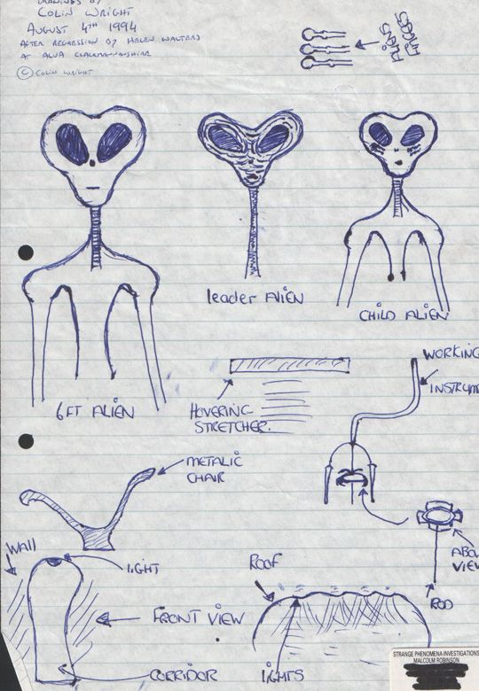
1990 to 2000 – The A7 Abduction Case?
November 1995 The UK Sunday Express
What He Saw. Real aliens?

Slide 14
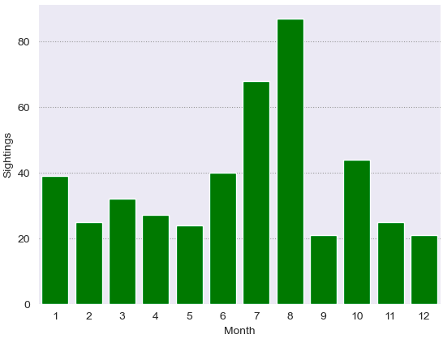
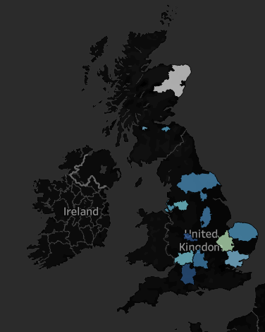
Deep Dive: 1996 to 1997 Peak – What Happened?
UK UFO Sightings for 1996 and 1997
UK UFO Sightings for 1996 and 1997

Slide 15
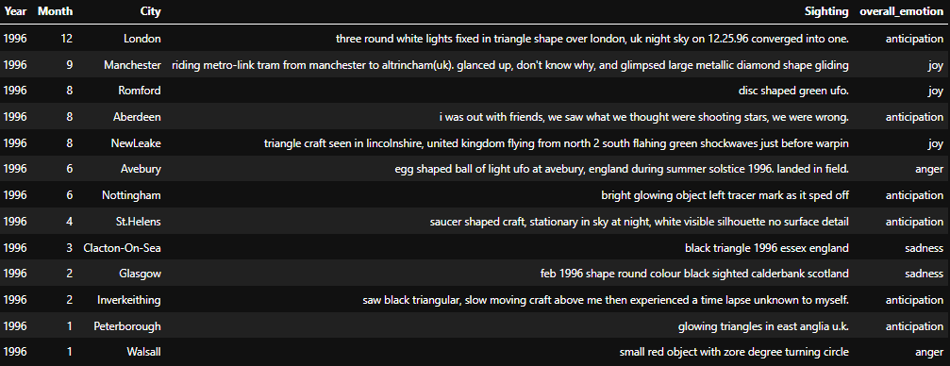
1996 – Is There More Anticipation and Joy Here?

Slide 16
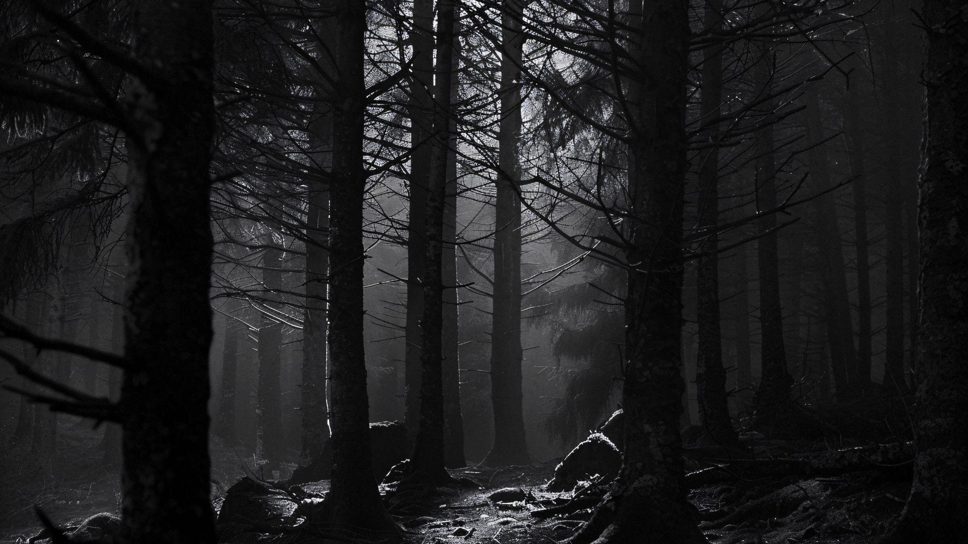
Chapter 4: 2000 to 2020 Reports Everywhere!

Slide 17
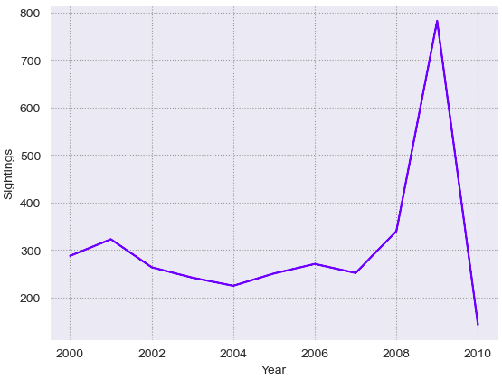
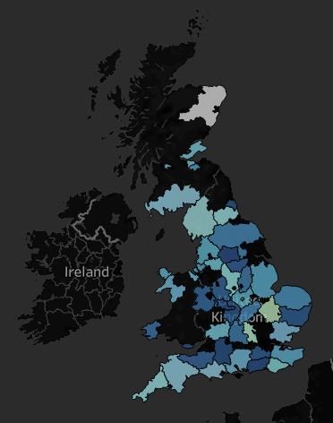
2000 to 2010 – That’s A Lot of Sightings!
UK UFO Sightings From 2000 to 2010
UK UFO Sightings from 2008 to 2009

Slide 18
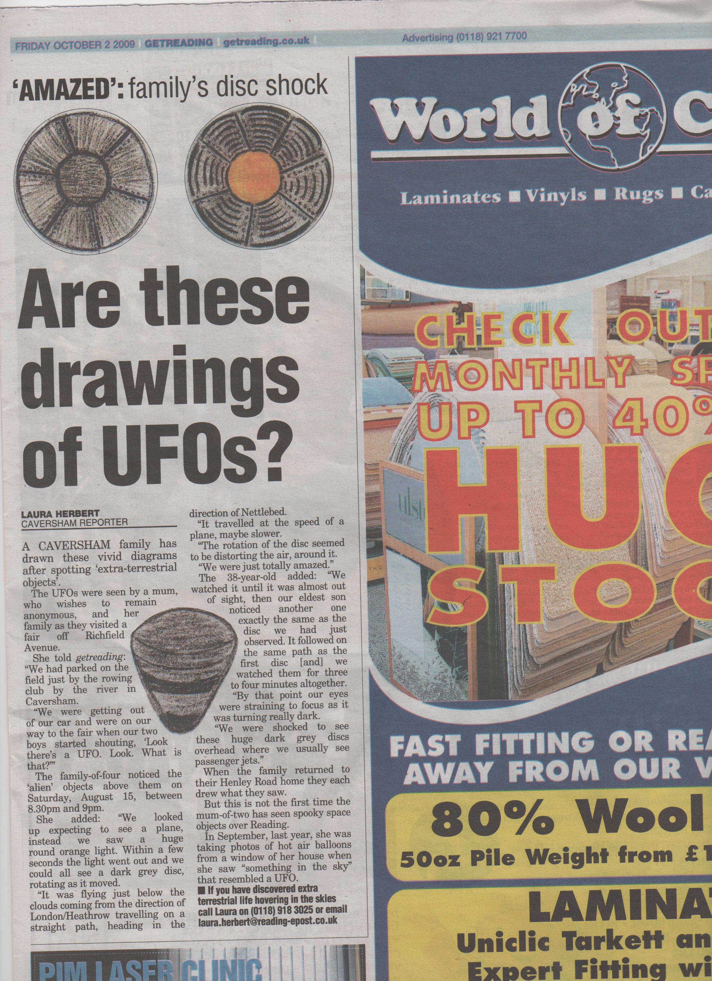
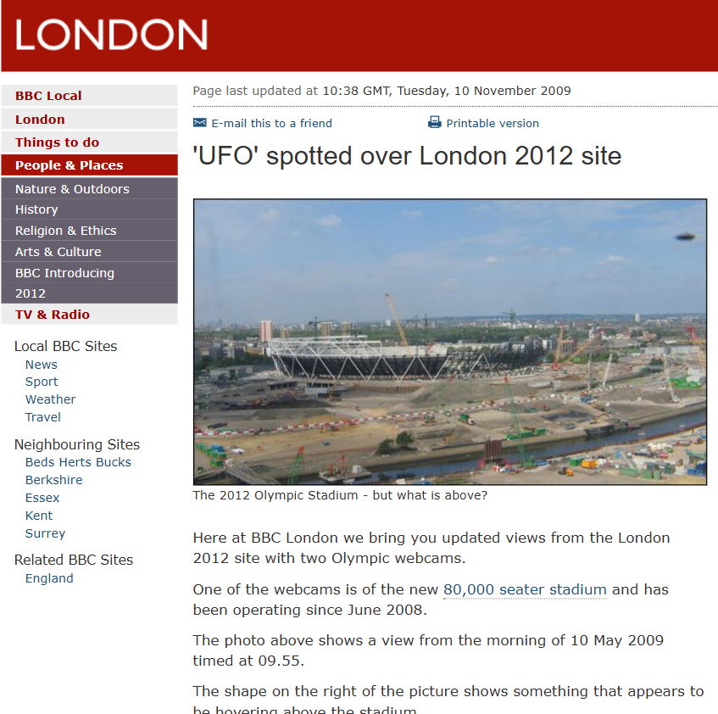
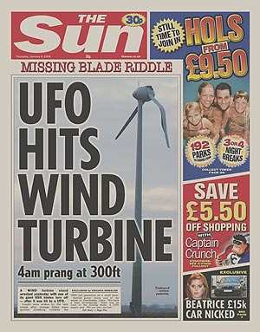
2000 to 2010 – UFOs Getting Media Attention

Slide 19
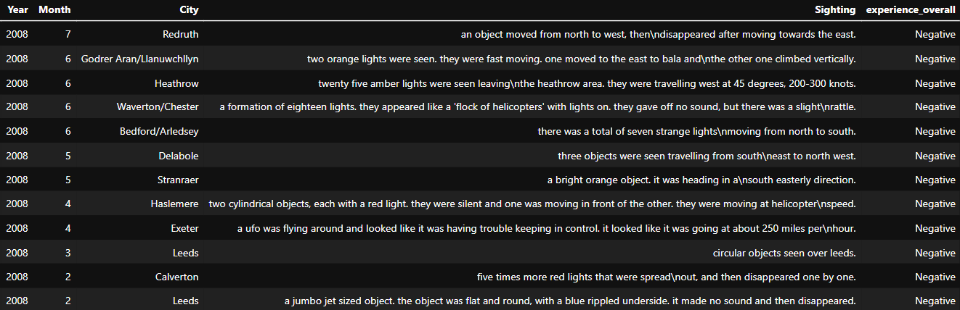
2008 – What Were People Experiencing?

Slide 20
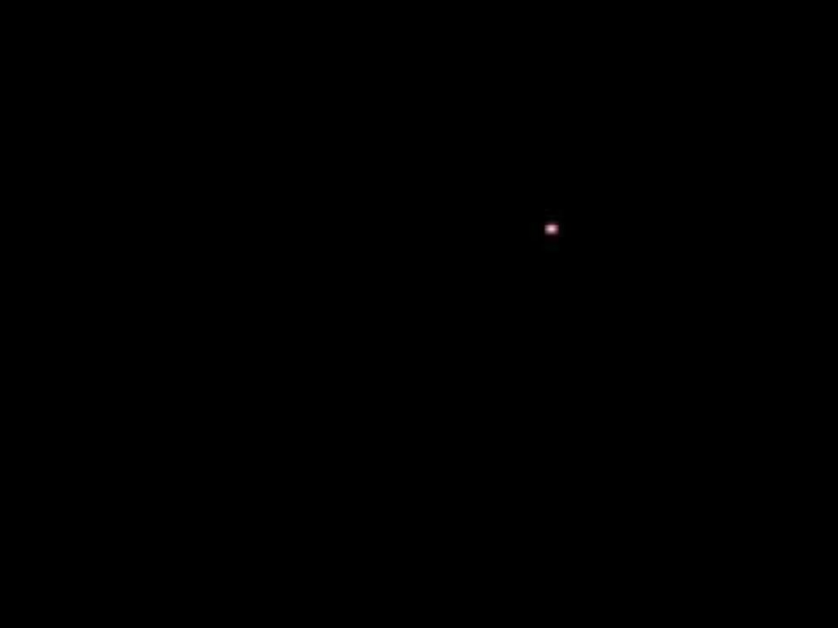
July, 2007, Surrey – Is This What Was Seen?
Warning: This video has some profanity!

Slide 21
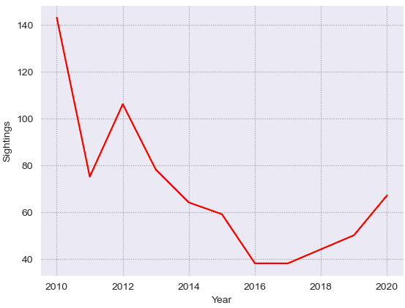
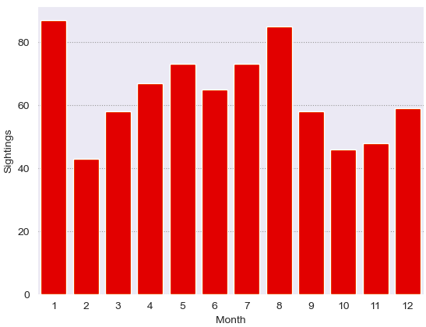
2010 to 2020 – Is The Hype Starting To Fade?
UK UFO Sightings from 2010 to 2020
UFO Sightings 2010 - 2020

Slide 22
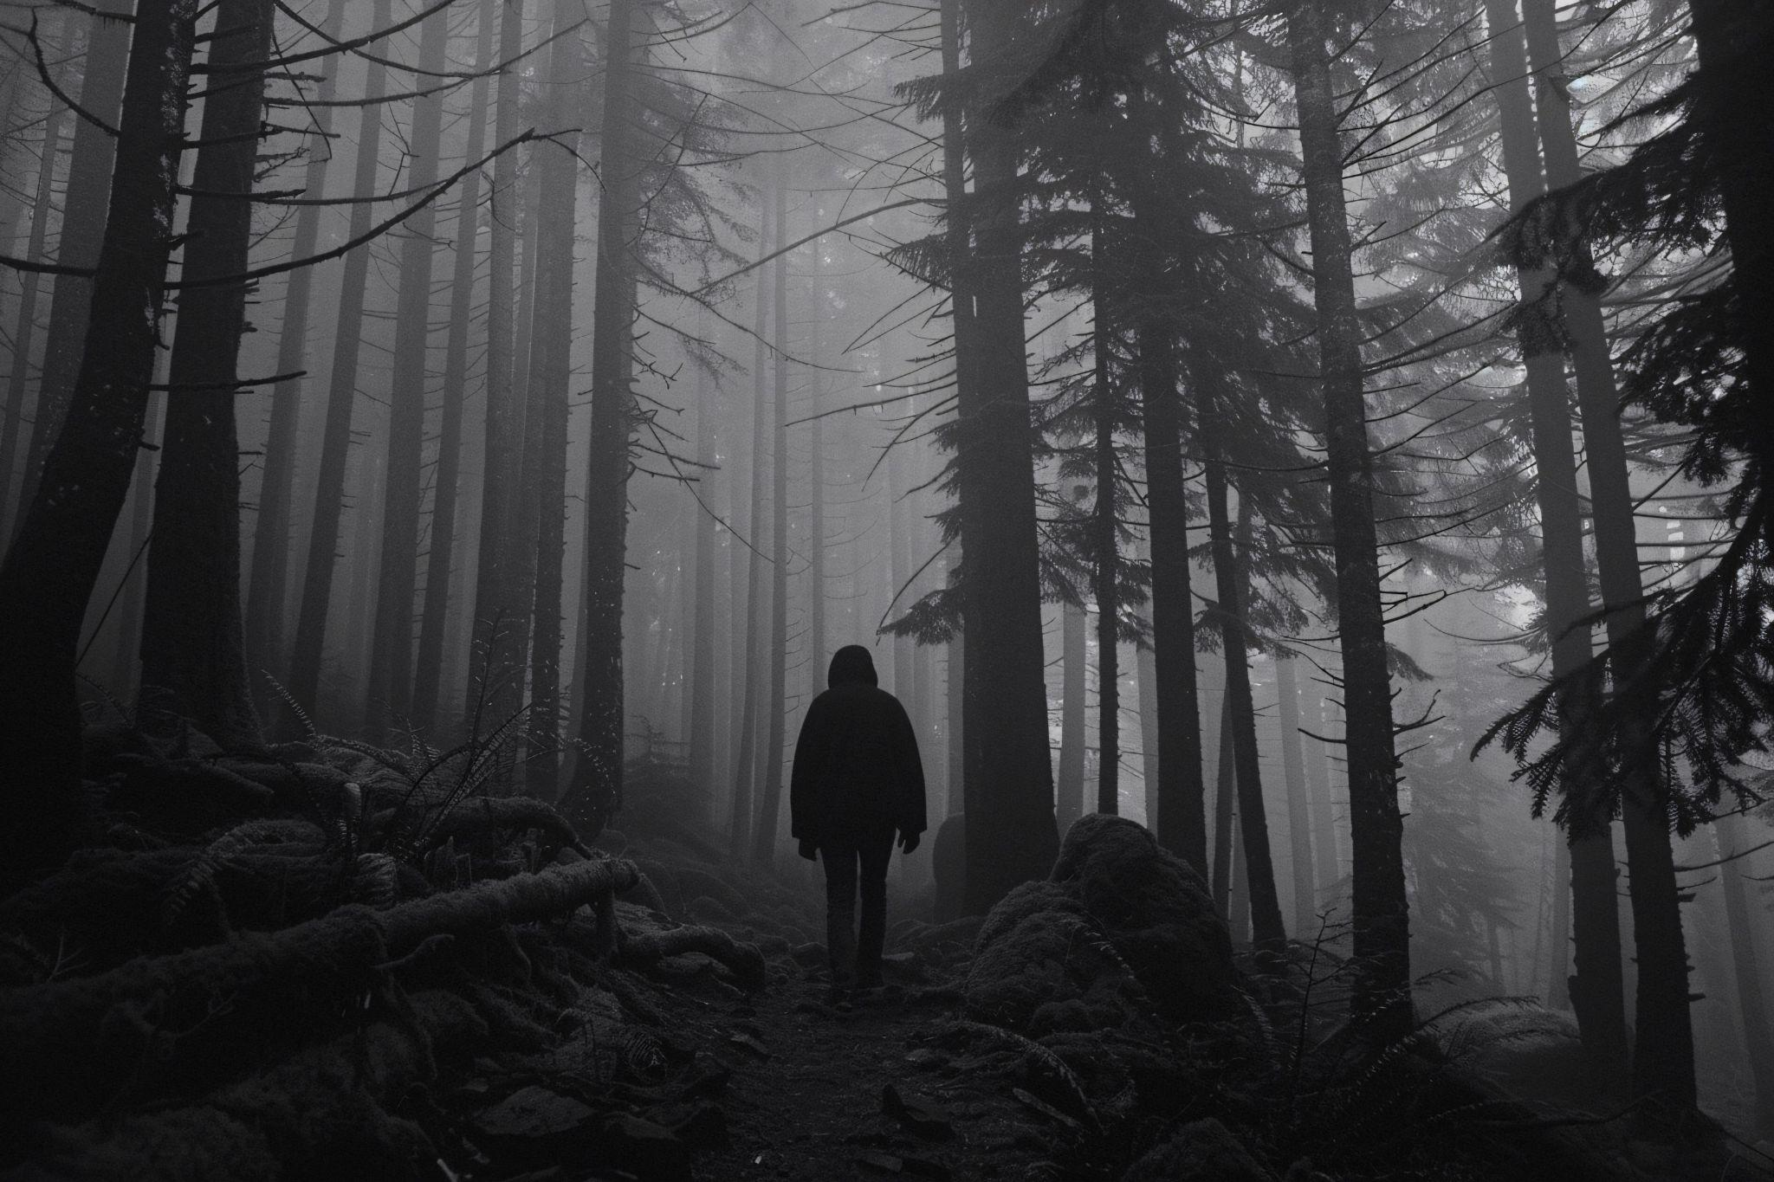
Chapter 5: 2020 to 2025
What’s The Story Right Now?

Slide 23
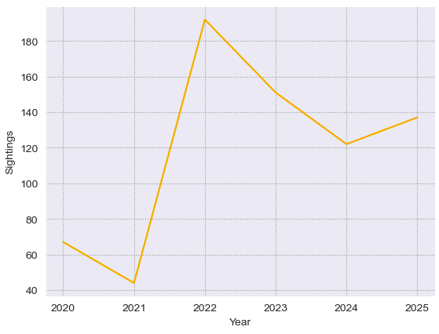
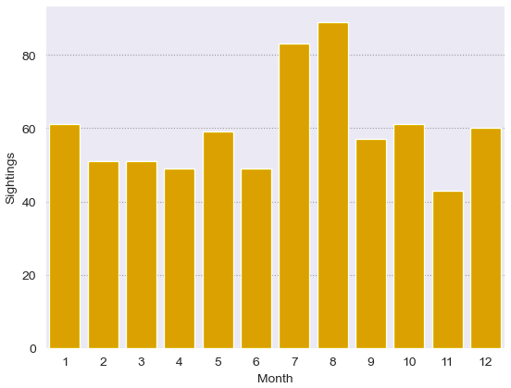
2020 to 2025 – Is There Something Going on?
UK UFO Sightings from 2020 to 2025
UK UFO Sightings 2020 – 2025 (July)

Slide 24
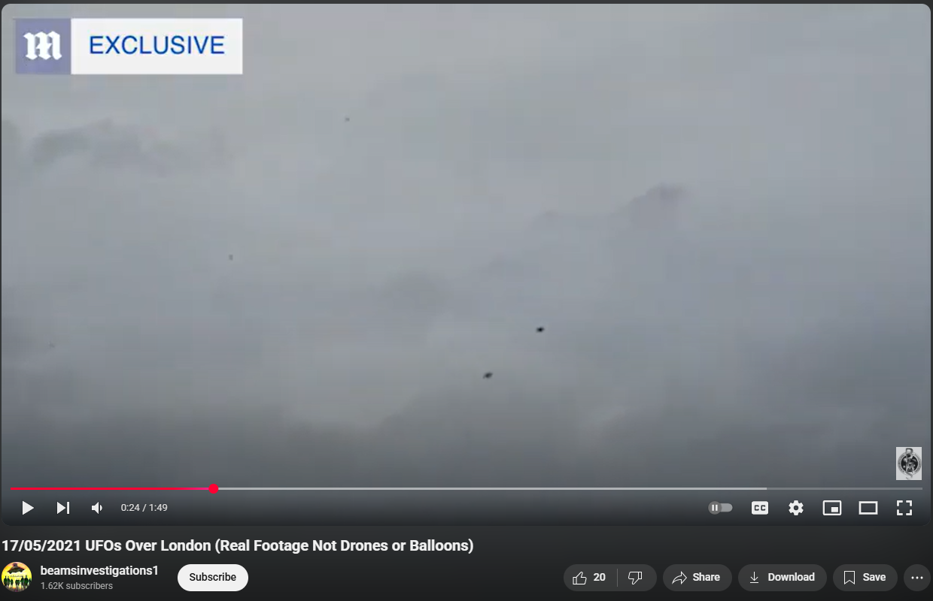
2020 to 2025 – More Strange Sightings?

Slide 25

2020 to 2025 – Where Are We Today?
“We are not dealing with science fiction — we are dealing with real events, real sightings, and real security implications,”
- Mark Christopher Lee

Slide 26
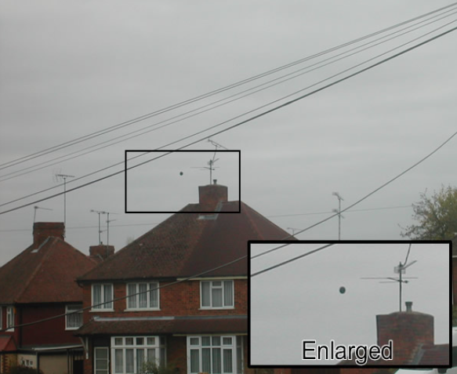
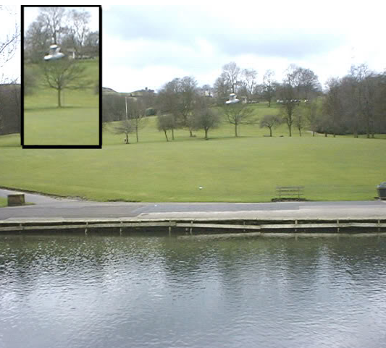
Bonus: Bloopers (Some Less Convincing Sightings!)
Berkshire, September 2009
Halifax, April 2004

Slide 27
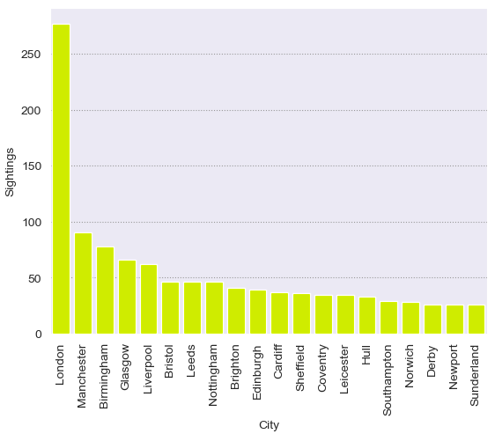
Finally, Who’s Most Likely to Be ABDUCTED?
The Most UFO sightings by City
1st Place:
Alex, Ruth, Lisa, Tim, Saka, Mustafa, Jagroop, Siân, and James!
2nd Place:
Hamza!
Safest:
Rahul, Harry, and Archie!
Conclusion?
Let’s all move to Norwich! (17th safest)

Slide 28
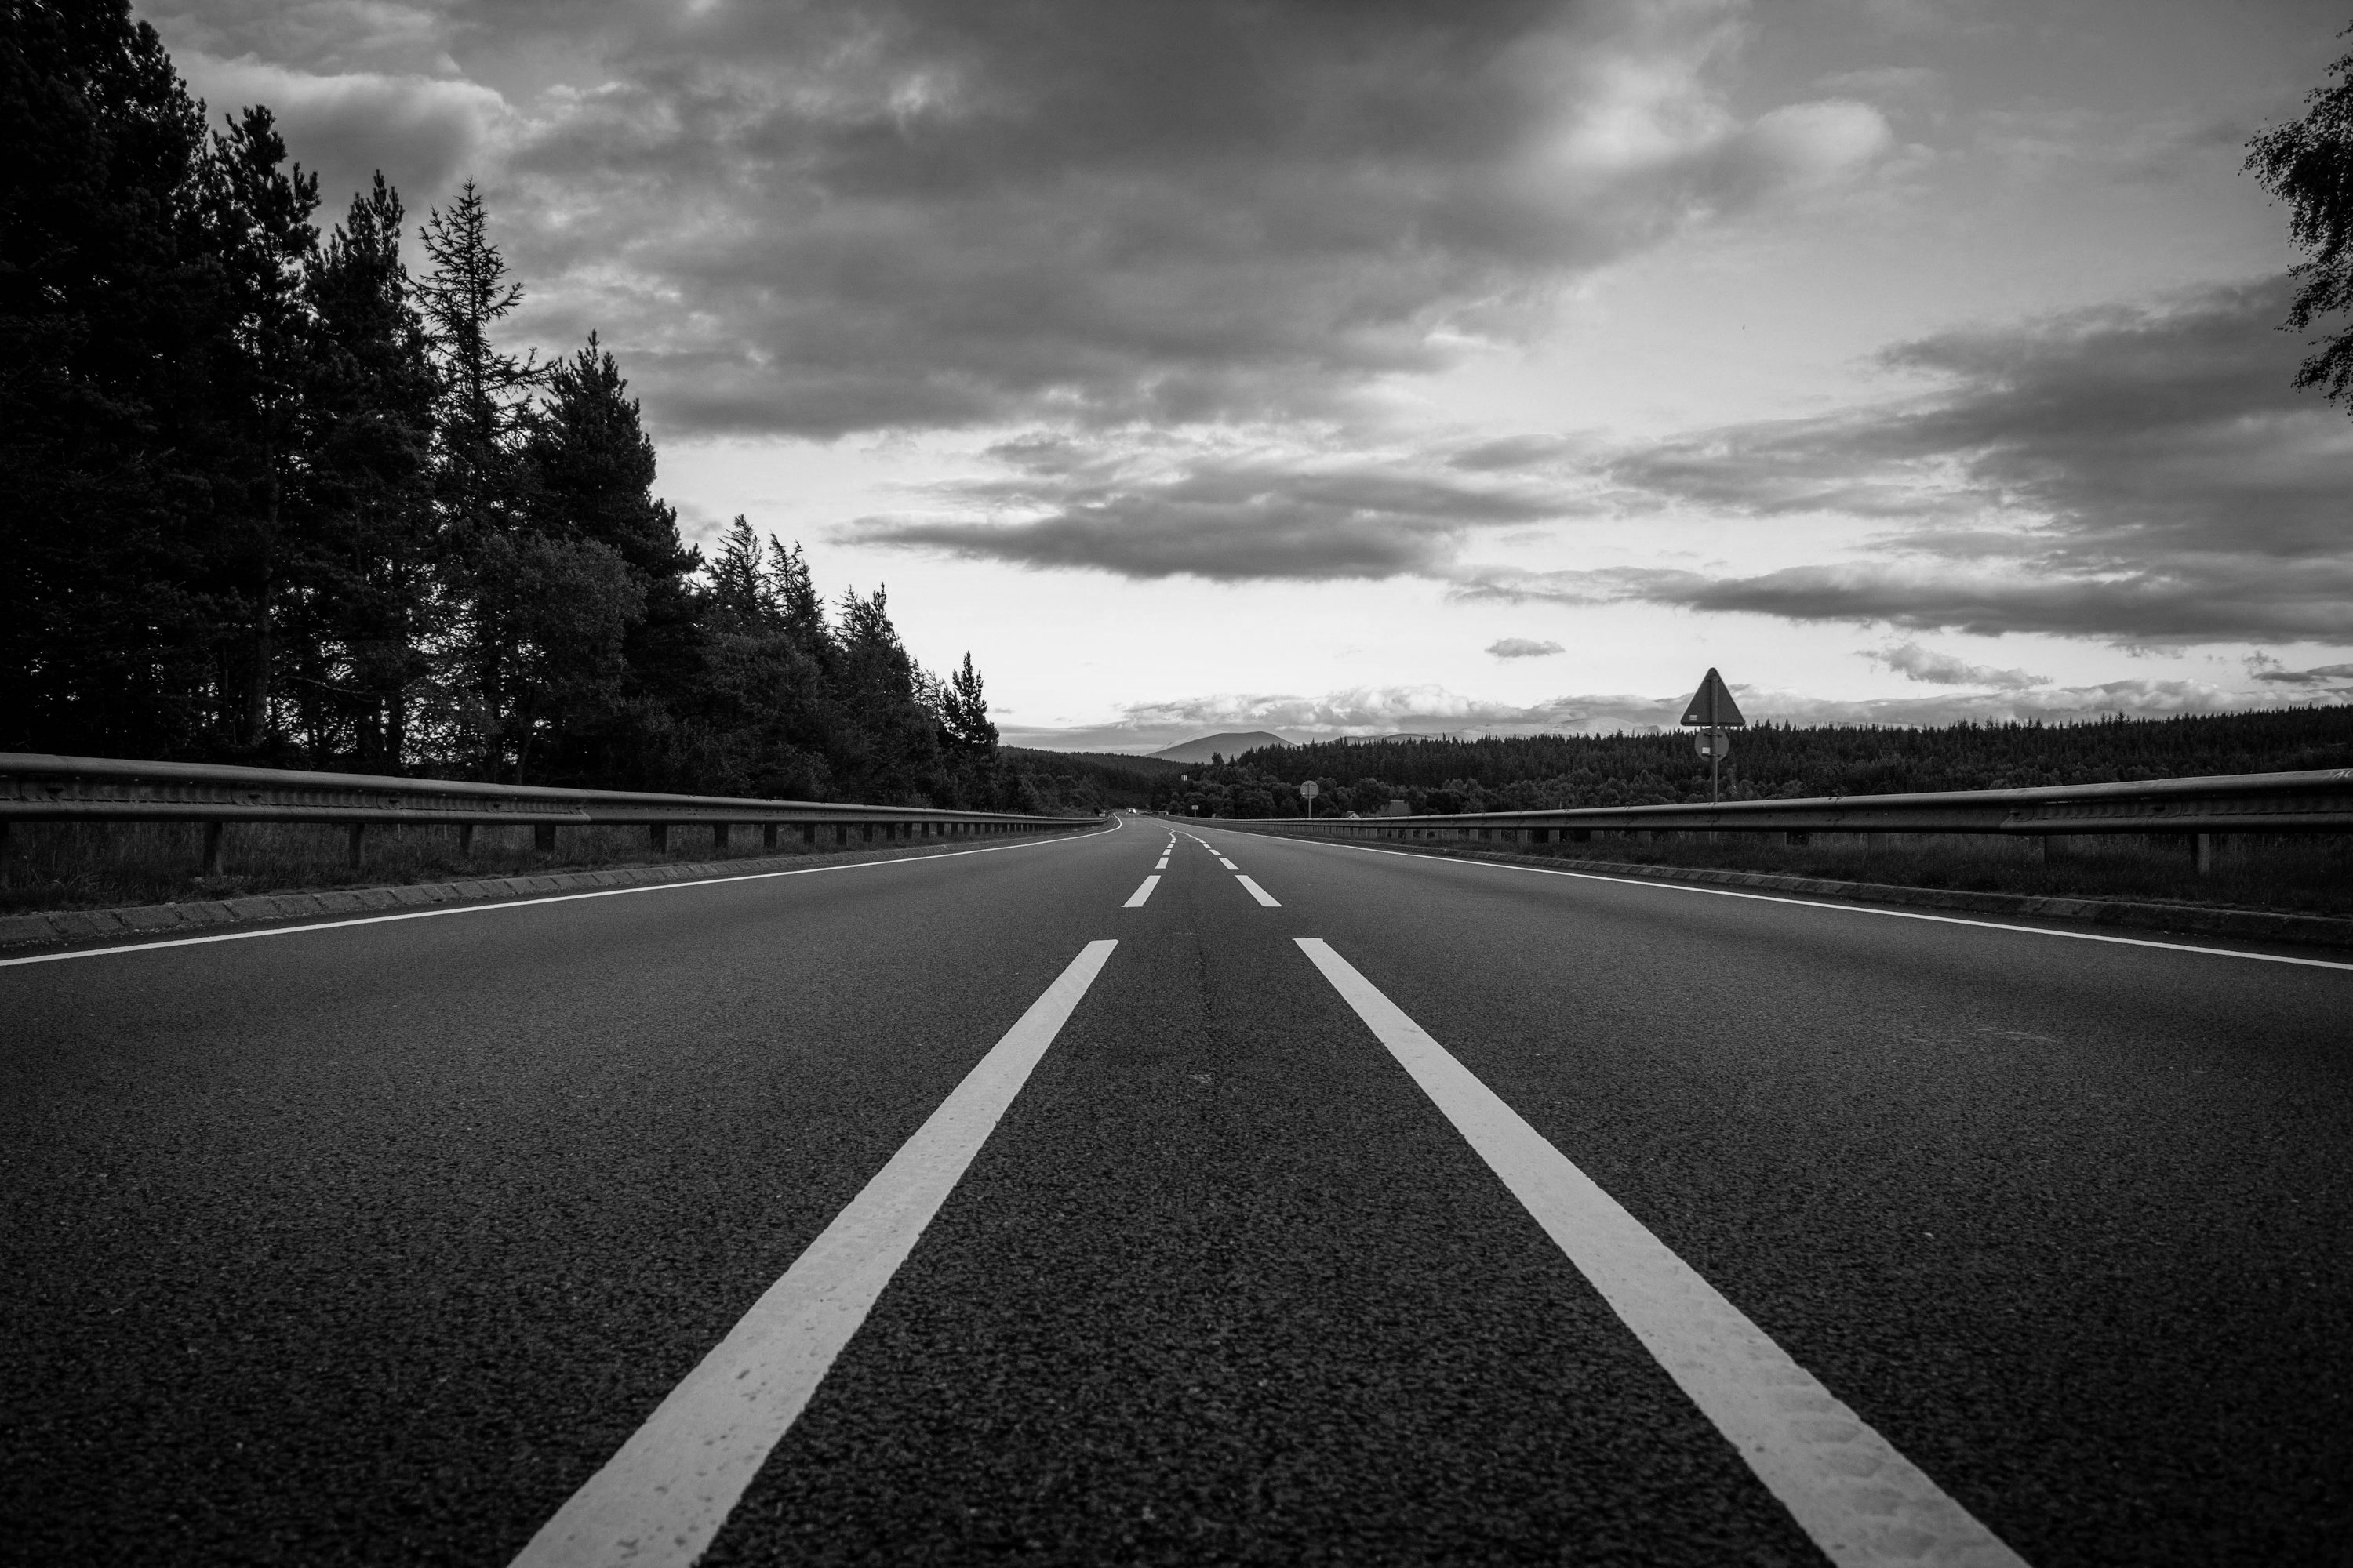
Reflection on The Project and my Time at Digital Futures

Slide 29
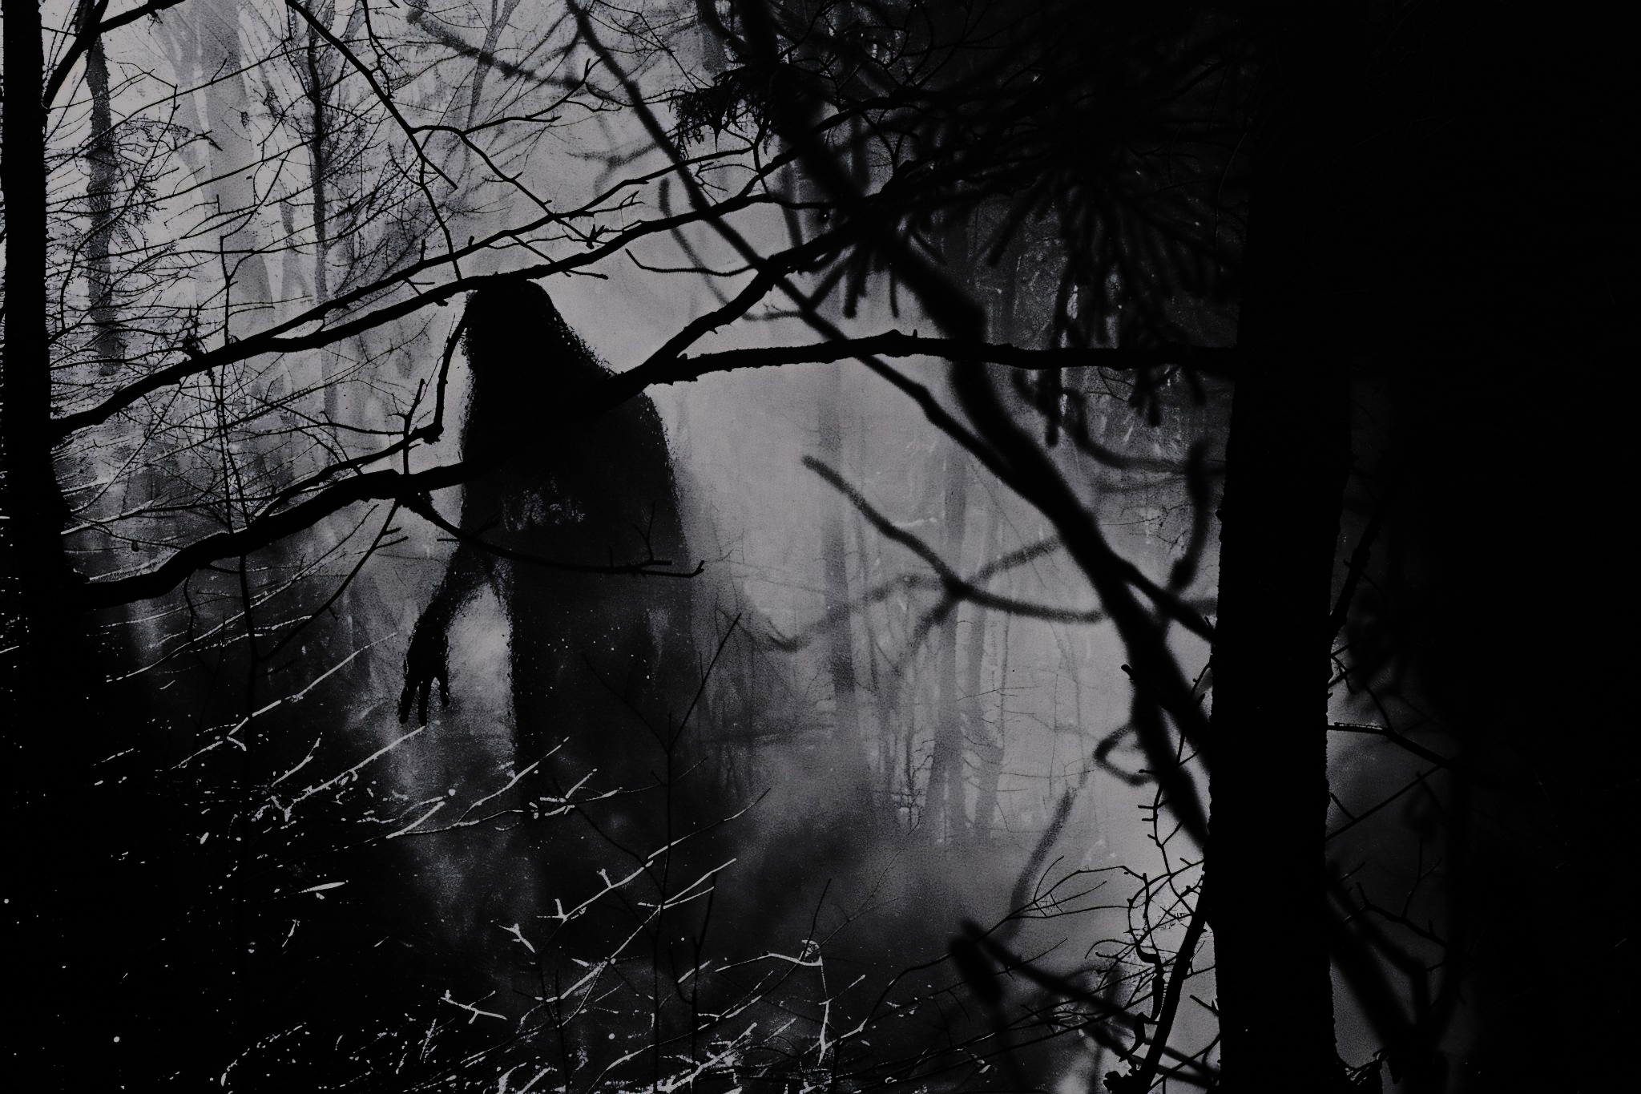
Thanks for Watching!
Any Questions?

Slide 30
Resources / References
Slide: The Rendlesham Forest Incident Summary
Picture 1: https://en.wikipedia.org/wiki/Rendlesham_Forest_incident
Picture 2: https://en.wikipedia.org/wiki/Rendlesham_Forest_incident
Picture 3: https://www.telegraph.co.uk/films/0/britains-roswell-really-happened-rendlesham-forest-ufo-incident/
Picture 4: https://griffmonster-walks.blogspot.com/2018/08/rendlesham-forest-and-butley-walk.html
Slide: 1980s to 1990s – Pictures:
Picture on left:
https://www.beamsinvestigations.org/UFO%201984,%20Weston%27s%20Grand%20Pier%20Somerset,%20UK.htm
Picture on right:
https://www.beamsinvestigations.org/01061987InterestingUFOCapturedOverlfracombeDevon.html

Slide 31
Resources / References
Slide: The A7 Abduction Case:
Alien drawing: https://www.beamsinvestigations.org/A70%20abduction%20with%20Colin%20Wright%20near%20Tarbrax,%20Scotland,%20southwest%20of%20Edinburgh%20that%20occurred%20August%2017,%201992.htm
Slide: 1990 to 2000 – From Sightings to Abductions?
November 1995 The UK Sunday Express:
https://www.beamsinvestigations.org/A70%20abduction%20with%20Colin%20Wright%20near%20Tarbrax,%20Scotland,%20southwest%20of%20Edinburgh%20that%20occurred%20August%2017,%201992.htm
Slide: 1990 to 2000 – More Media?
X-Files image: https://www.imdb.com/title/tt0106179/

Slide 32
Resources / References
Slide: 1990 to 2000 – 1998 Video of a UFO
Video link: https://www.beamsinvestigations.org/Flying%20Saucer%20Over%20Weymouth%201998%20-%20Video%20Accredited%20by%20Scientists%20as%20Genuine%20Daylight%20UFO%20Stabilized.htm
Slide: 2000 – 2010: Newspaper Reports
Image on Left:
https://www.beamsinvestigations.org/our%20sighting.jpg
Centre image:
http://news.bbc.co.uk/local/london/hi/people_and_places/newsid_8352000/8352111.stm
Image on right: https://www.beamsinvestigations.org/I%20Smell%20a%20Rat%20in%20the%20Conisholme%20Affair.htm

Slide 33
Resources / References
Slide: 1990 to 2000 – 1998 Video of a UFO
Picture on left:
https://www.beamsinvestigations.org/2005%20%20%20%20UFO%20Photo%20Tintagel,%20Cornwall,%20United%20Kingdom.htm
Video on right:
https://www.beamsinvestigations.org/july21.html
Slide: 2020 to 2025 – Strange Sightings
Snapshot taken from: https://www.youtube.com/watch?v=XPBZa83mXWI

Slide 34
Resources / References
Slide: 2020 to 2025 – Where Are We Today?
Quotes and picture taken from: https://www.journalism.co.uk/press-releases/new-ufo-disclosure-group-launches-in-uk-with-screening-of-royal-ufo-film/s66/a1245968/
Slide Bonus 1: The Vast Data on Sightings:
Picture on top: https://www.gov.uk/government/publications/ufo-reports-in-the-uk
Picture on bottom: https://nuforc.org/
Screen recording: https://www.beamsinvestigations.org/ufo-reports.html
Slide Bonus 2: Bloopers:
Picture on left: https://www.beamsinvestigations.org/BlackHoleUFO28092009Berks.html
Picture on right: https://www.beamsinvestigations.org/A%20Supposed%20UFO%20Photographed%20in%20Shibden%20Park%20Halifax,%20Yorks,%20UK%20-%20April,%202004.htm

Slide 35
Resources / References
2 Themes Used:
Please see the next 2 attribution slides for the themes used:

Slide 36

Thanks
Do you have any questions?
addyouremail@freepik.com | +91 620 421 838 | yourcompany.com
Please, keep this slide for the attribution

Slide 37
THANK YOU
Do you have any questions?
youremail@freepik.com
+00 000 000 000
yourwebsite.com
Please keep this slide for attribution

